Slide 1

Toolkit Doc12 Head Tilt Stage Panels
April 30, 2010

Slide 2
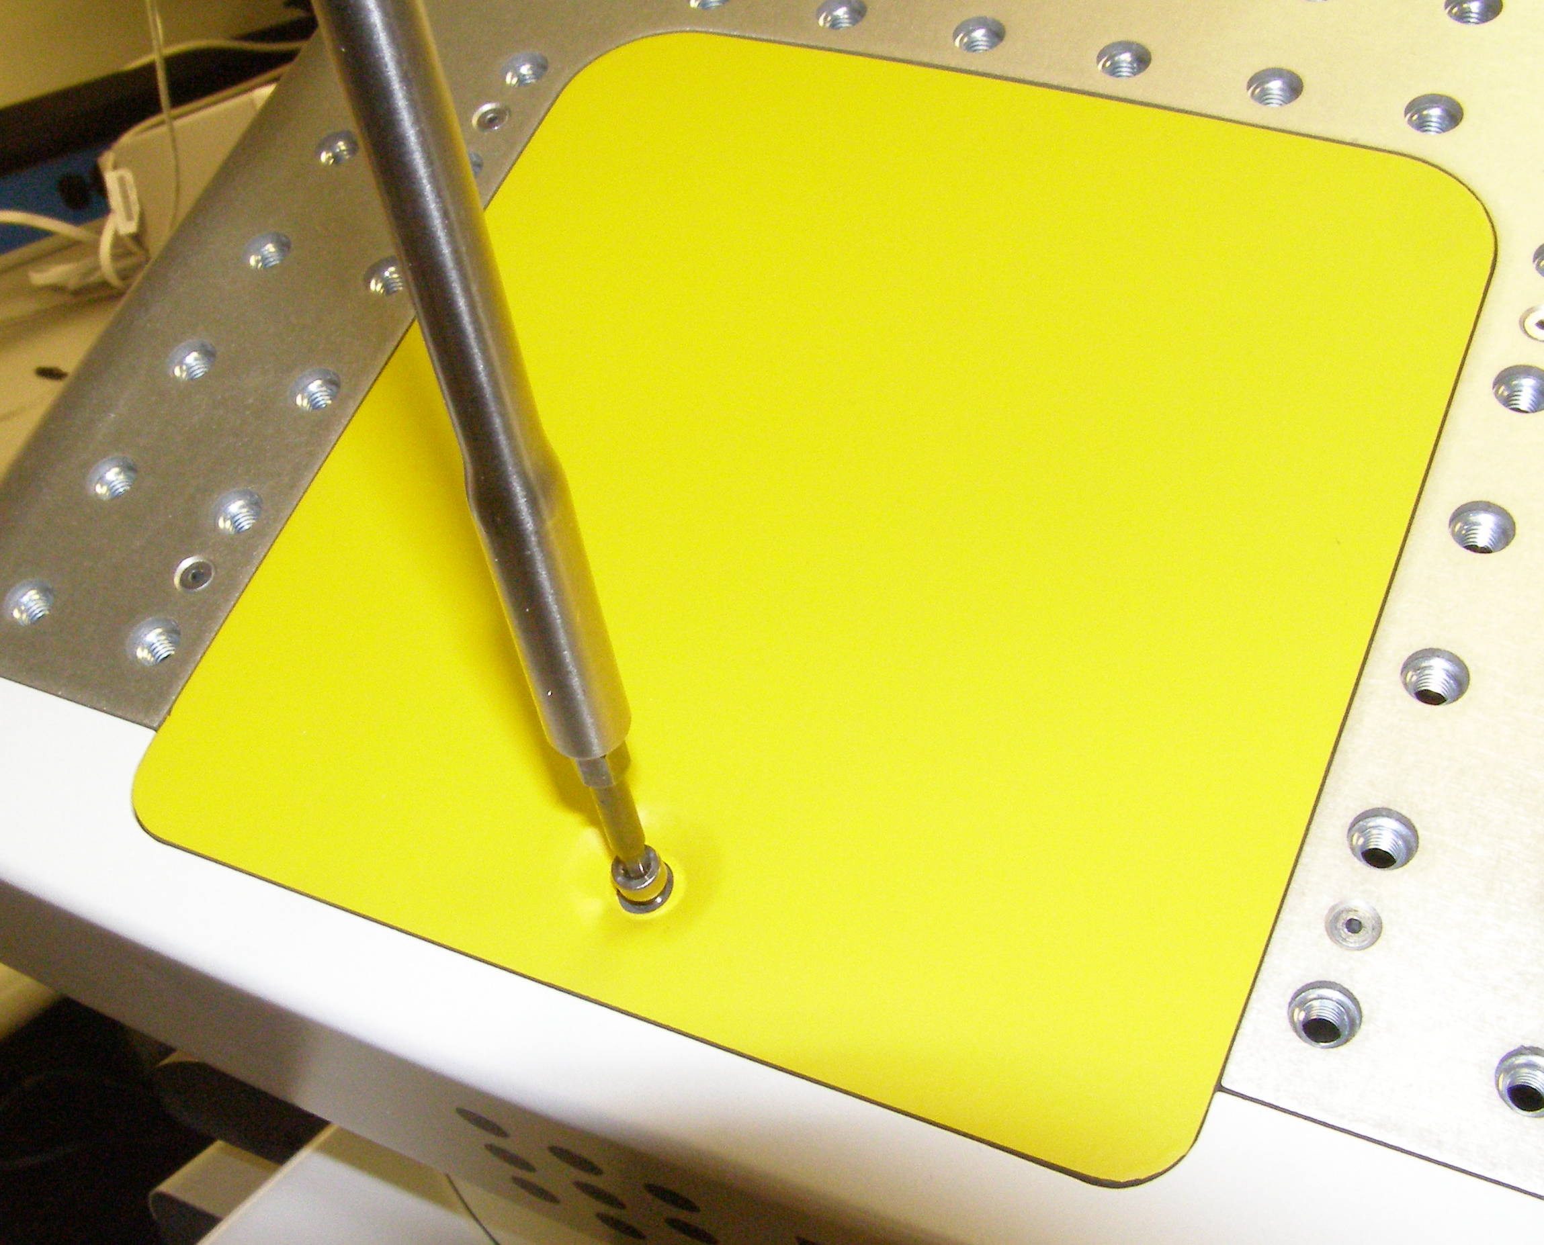
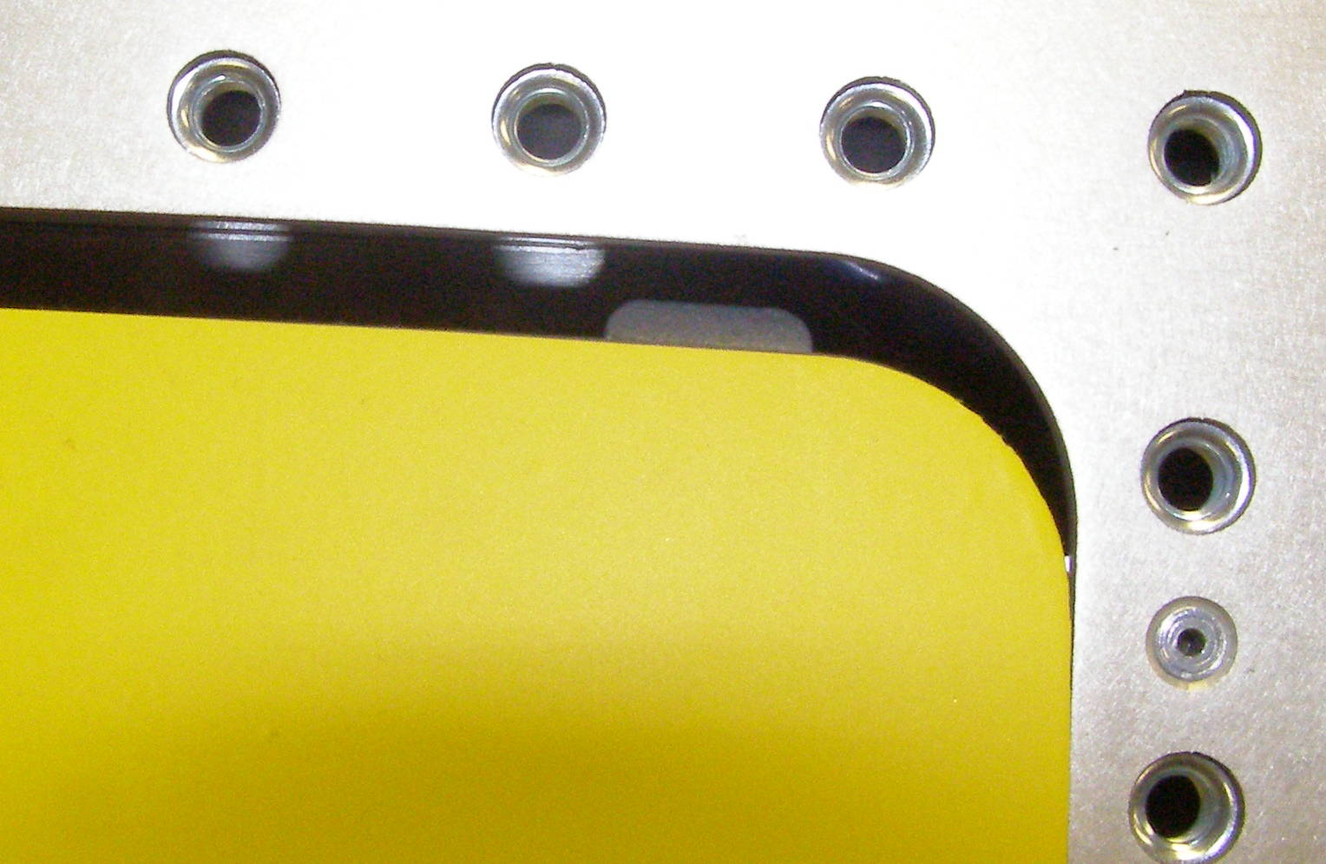
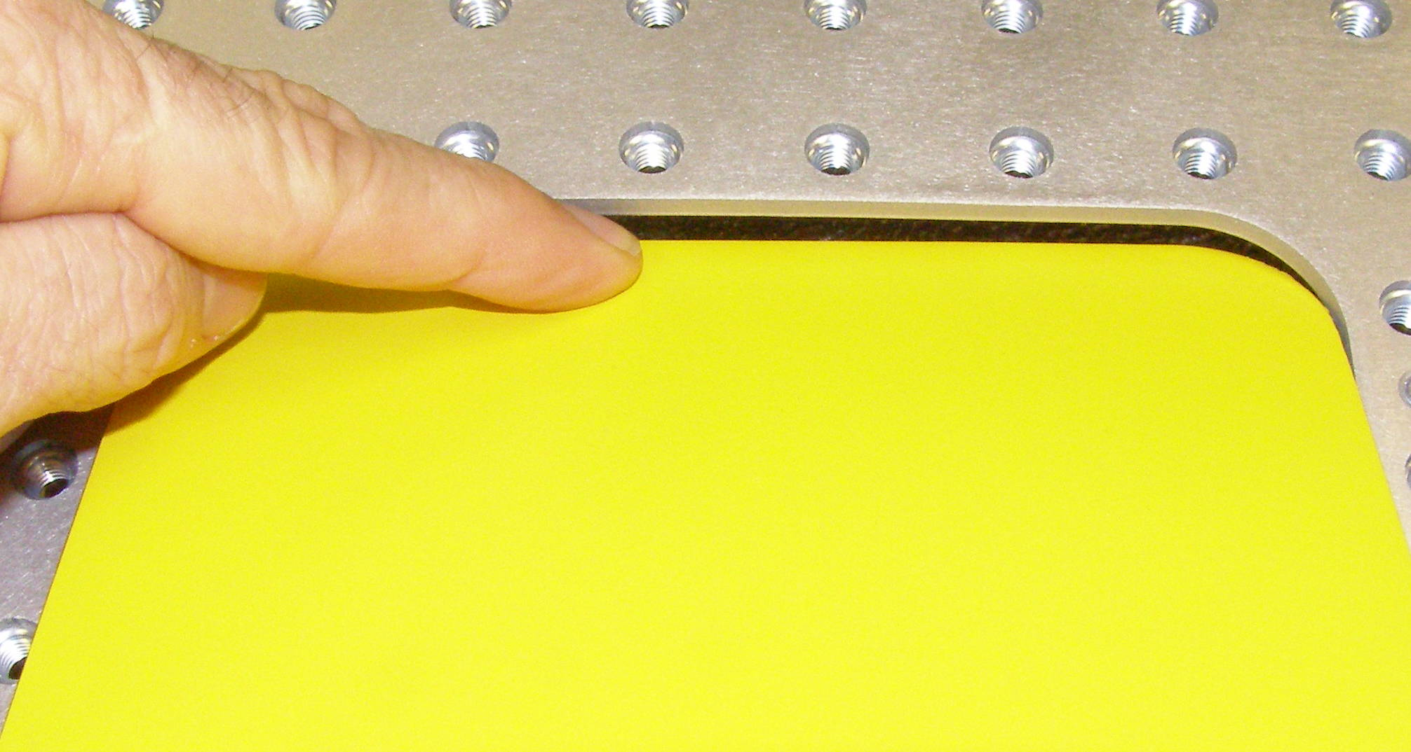
Head Hatch R/R
Head Hatch, Removal – 2445
  Tilt the Head completely backwards.
  Using the 3mm bit with the T-handle driver, remove the screw. 3065-10 (Fig 1)
  Press on the forward edge of the Hatch to pivot the rear up, lift it up and out. (Fig 2).
Head Hatch, Install
  Insert the retaining lips in the front of the Hatch under the edge of the Head Bonnet. (Fig 3)
  Using Loctite 248, install the screws and torque to 1.36Nm using the Large torque driver.
Fig 1
Fig 3
Fig 2

Slide 3
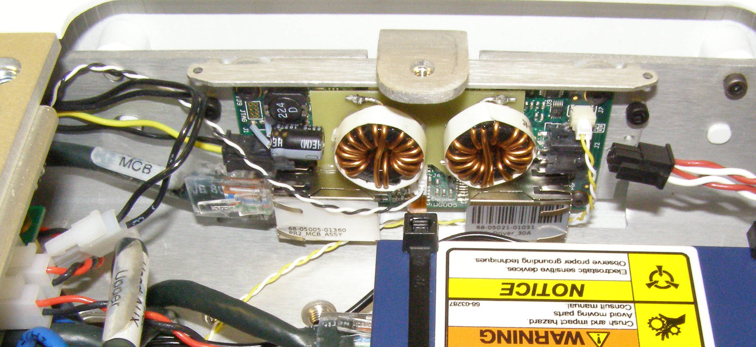
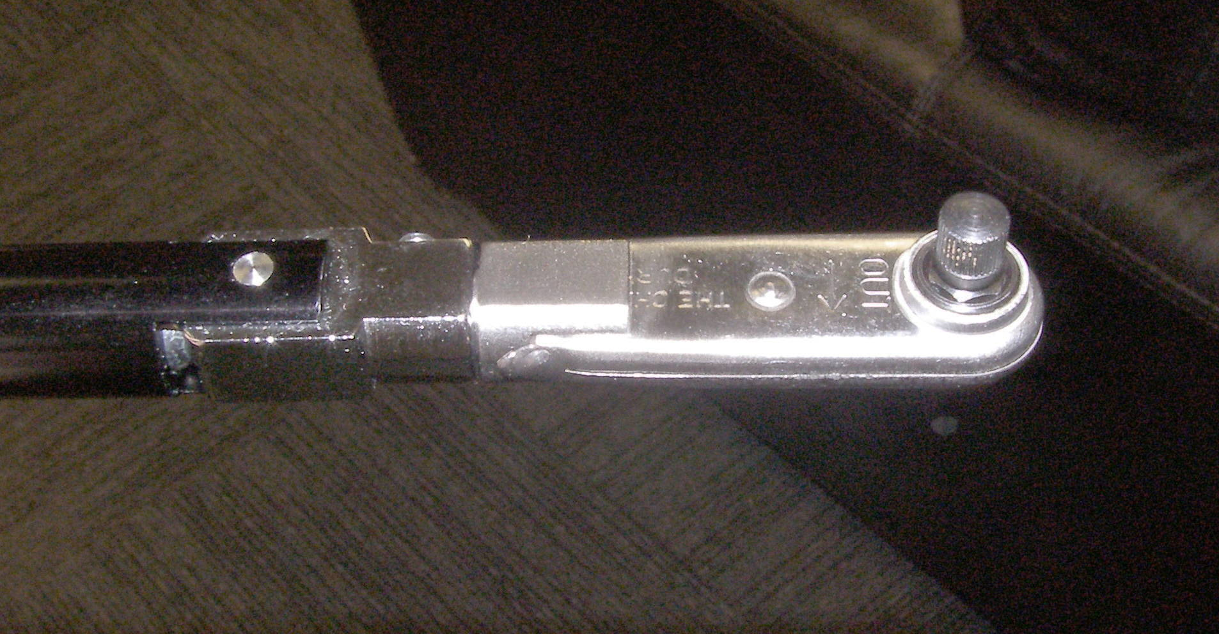
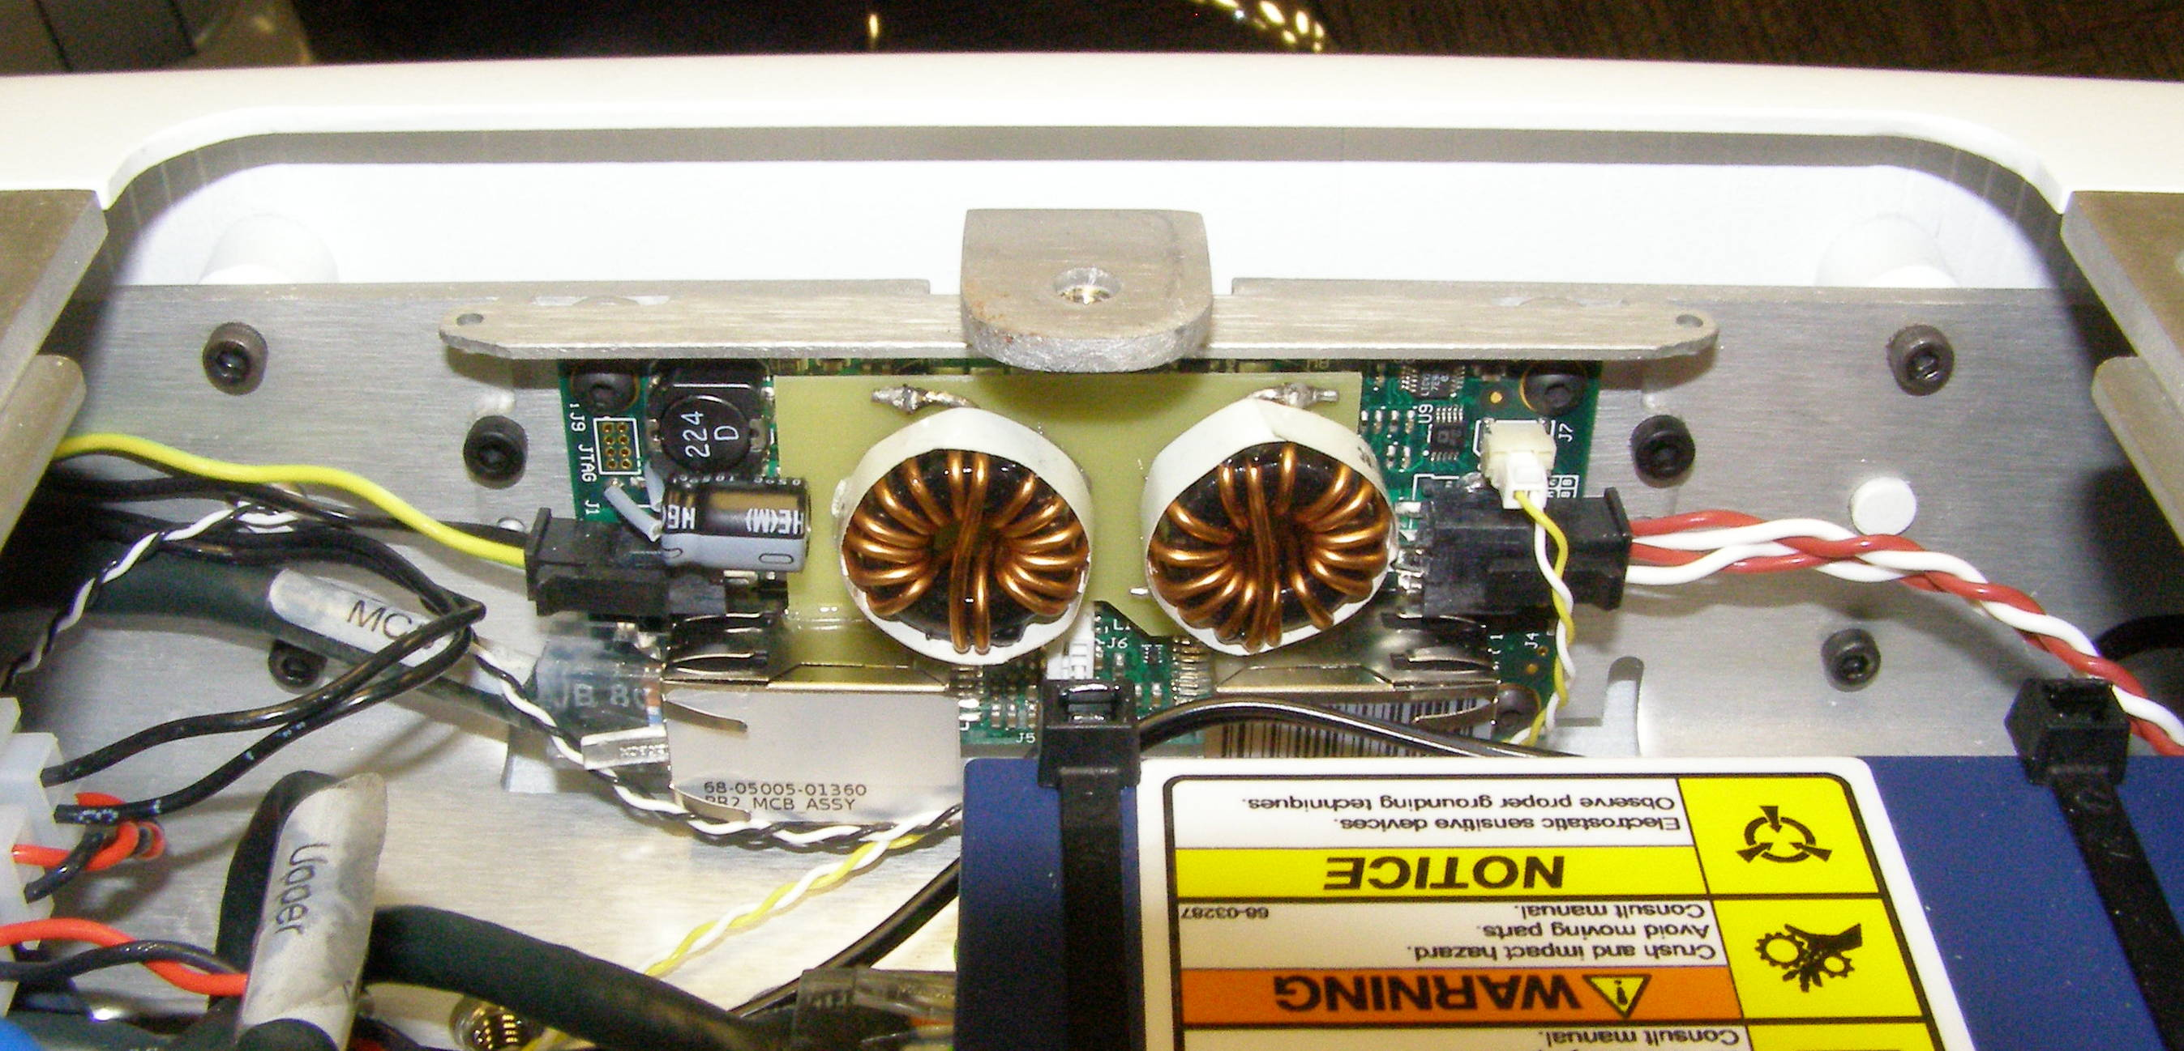
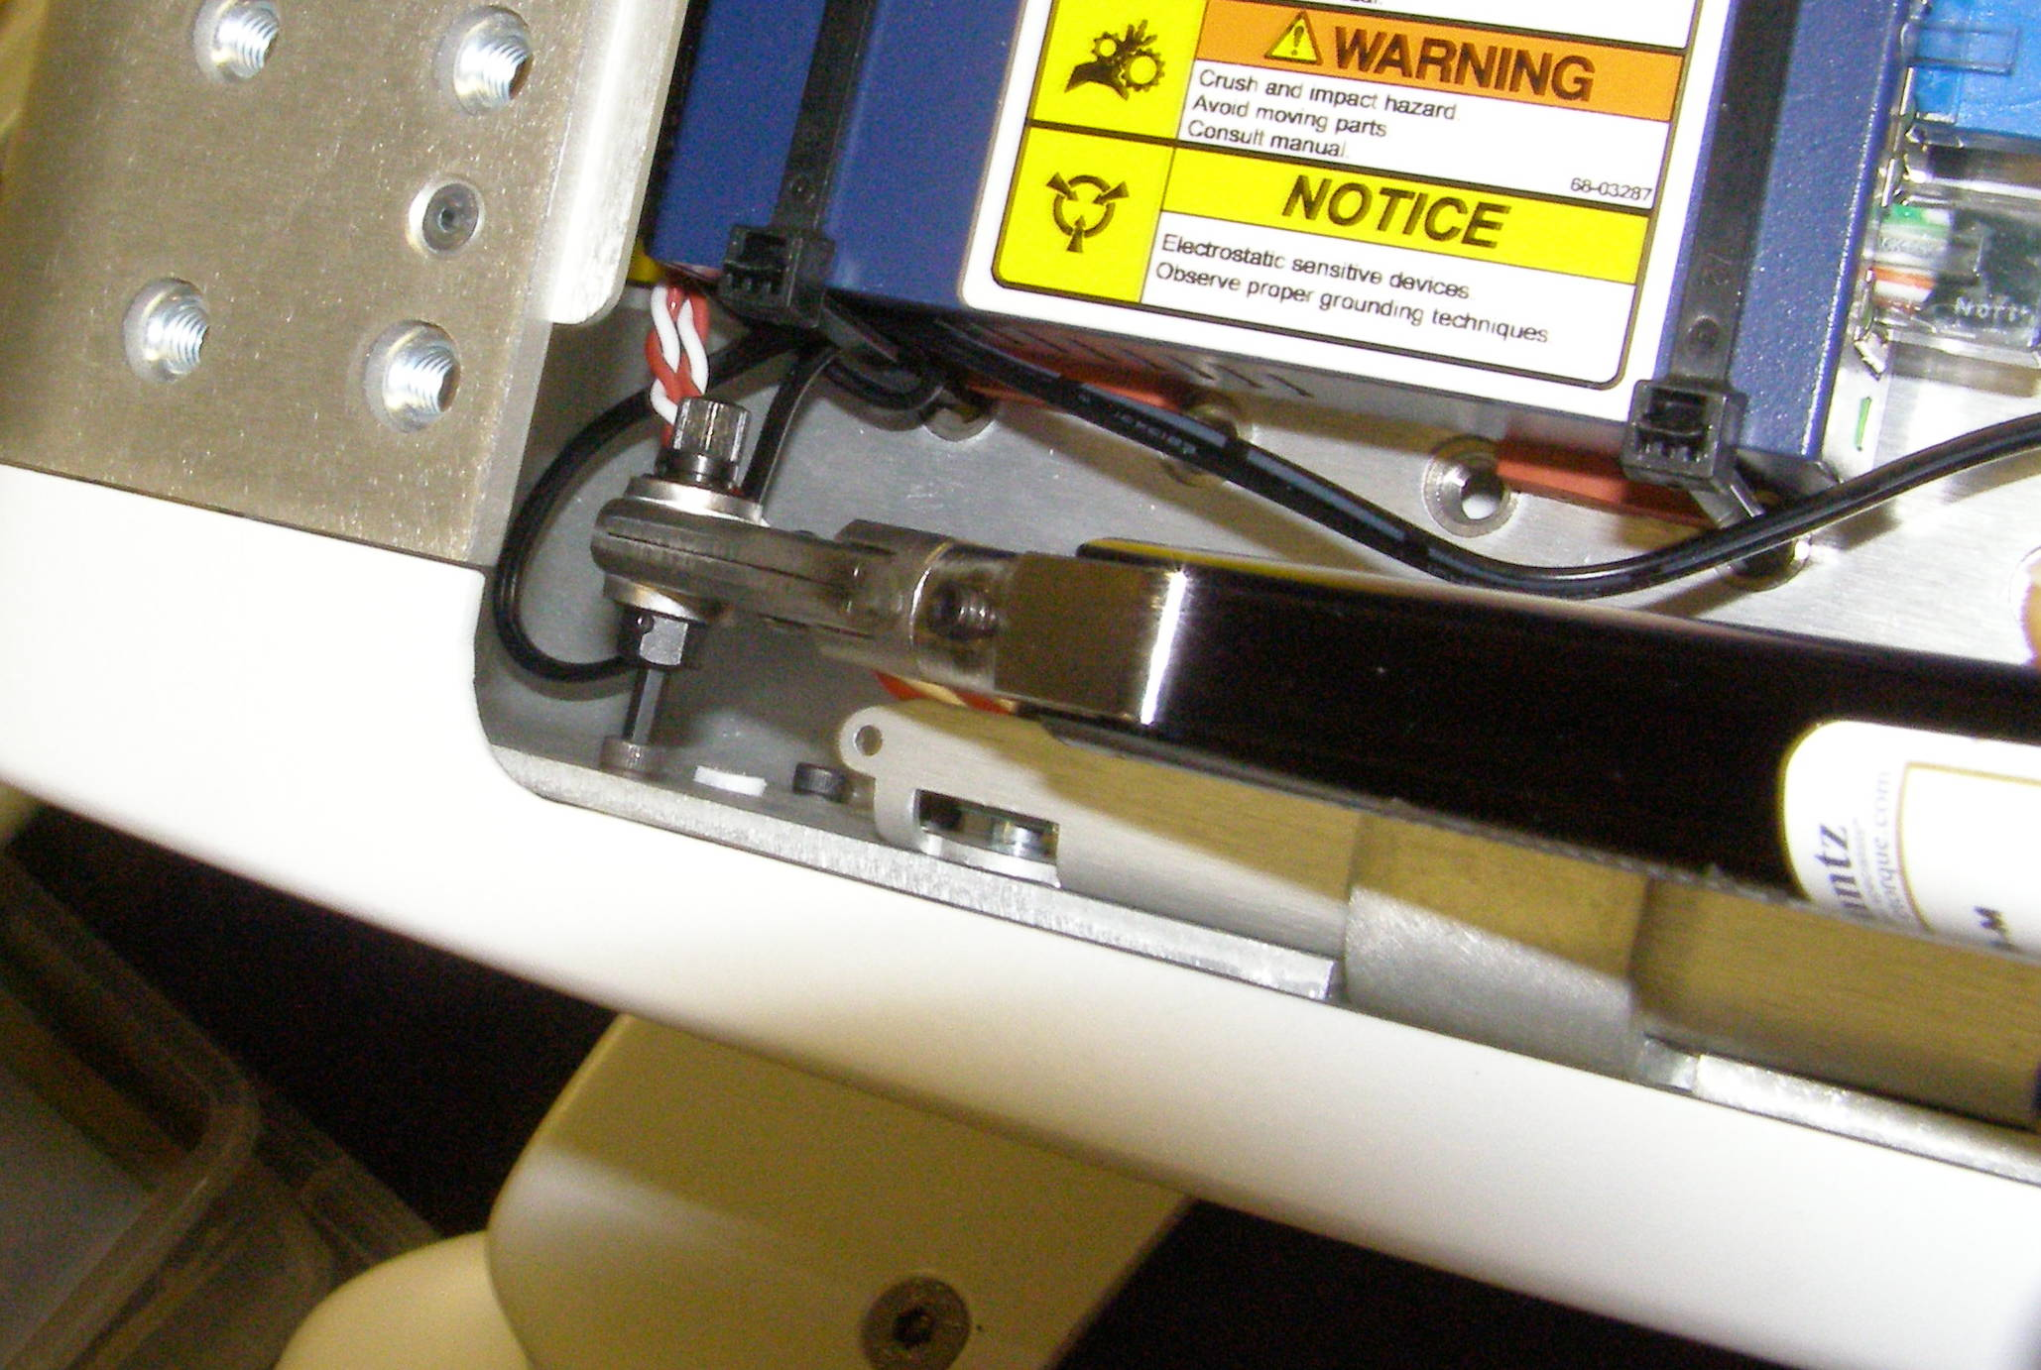
Head Bezel Rear R/R
Head Bezel Rear – 2444
  Remove the Head Pan-tilt Right and Left first.
  Remove the Head Hatch.
  Tilt the Head all the way forward.
  To facilitate screw removal disconnect the 3 connectors as shown and carefully move the cables out of the way as needed to gain access to the mounting screws. (Fig 1)
  Using the 2.0Nm right angle torque wrench together with the 2.5mm short bit with (OUT) facing up, remove the 4 screws. 2009-08 (Fig 2,3,4)
Head Bezel Rear, Install
  Rttach the ratchet head to the 0.68Nm right angle torque wrench. With (IN) facing up and the 2.5mm short bit.
  Using Loctite 248, install the 4 screws and torque to 1.36Nm using the Large torque driver.
Fig 1
Fig 2
Fig 4
Fig 3

Slide 4
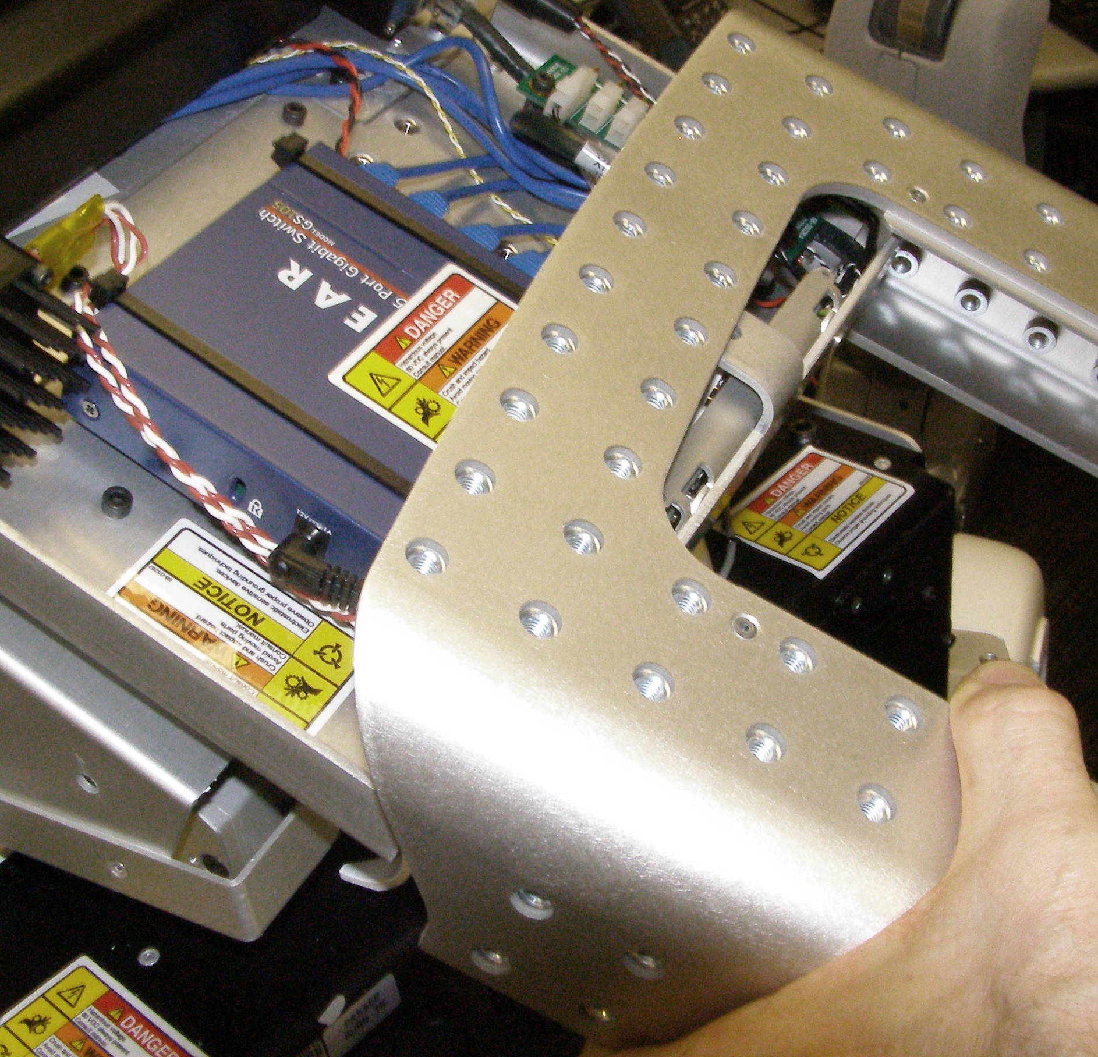
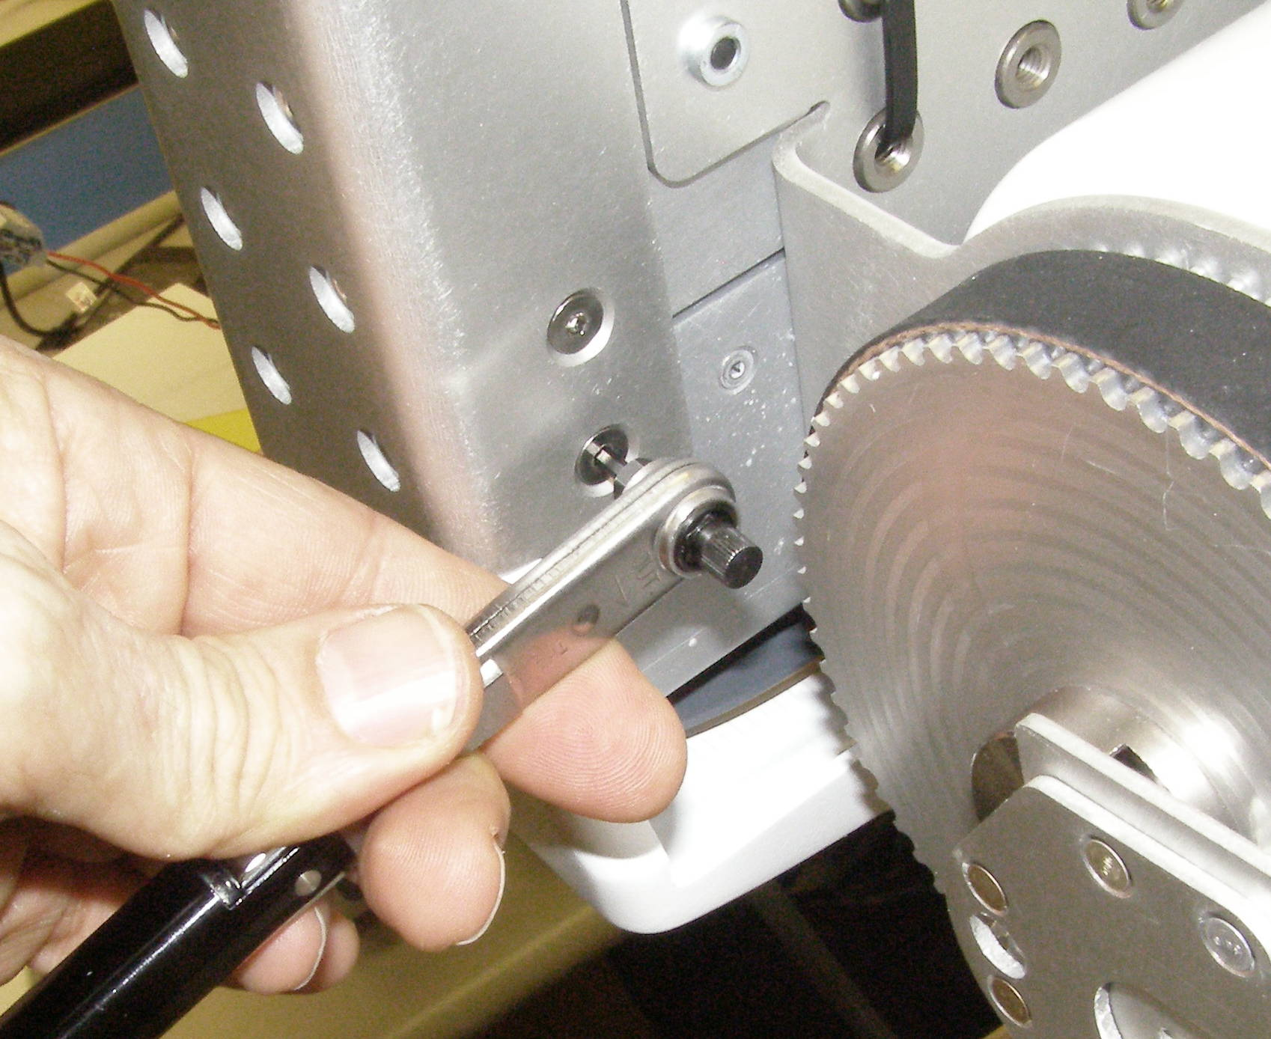
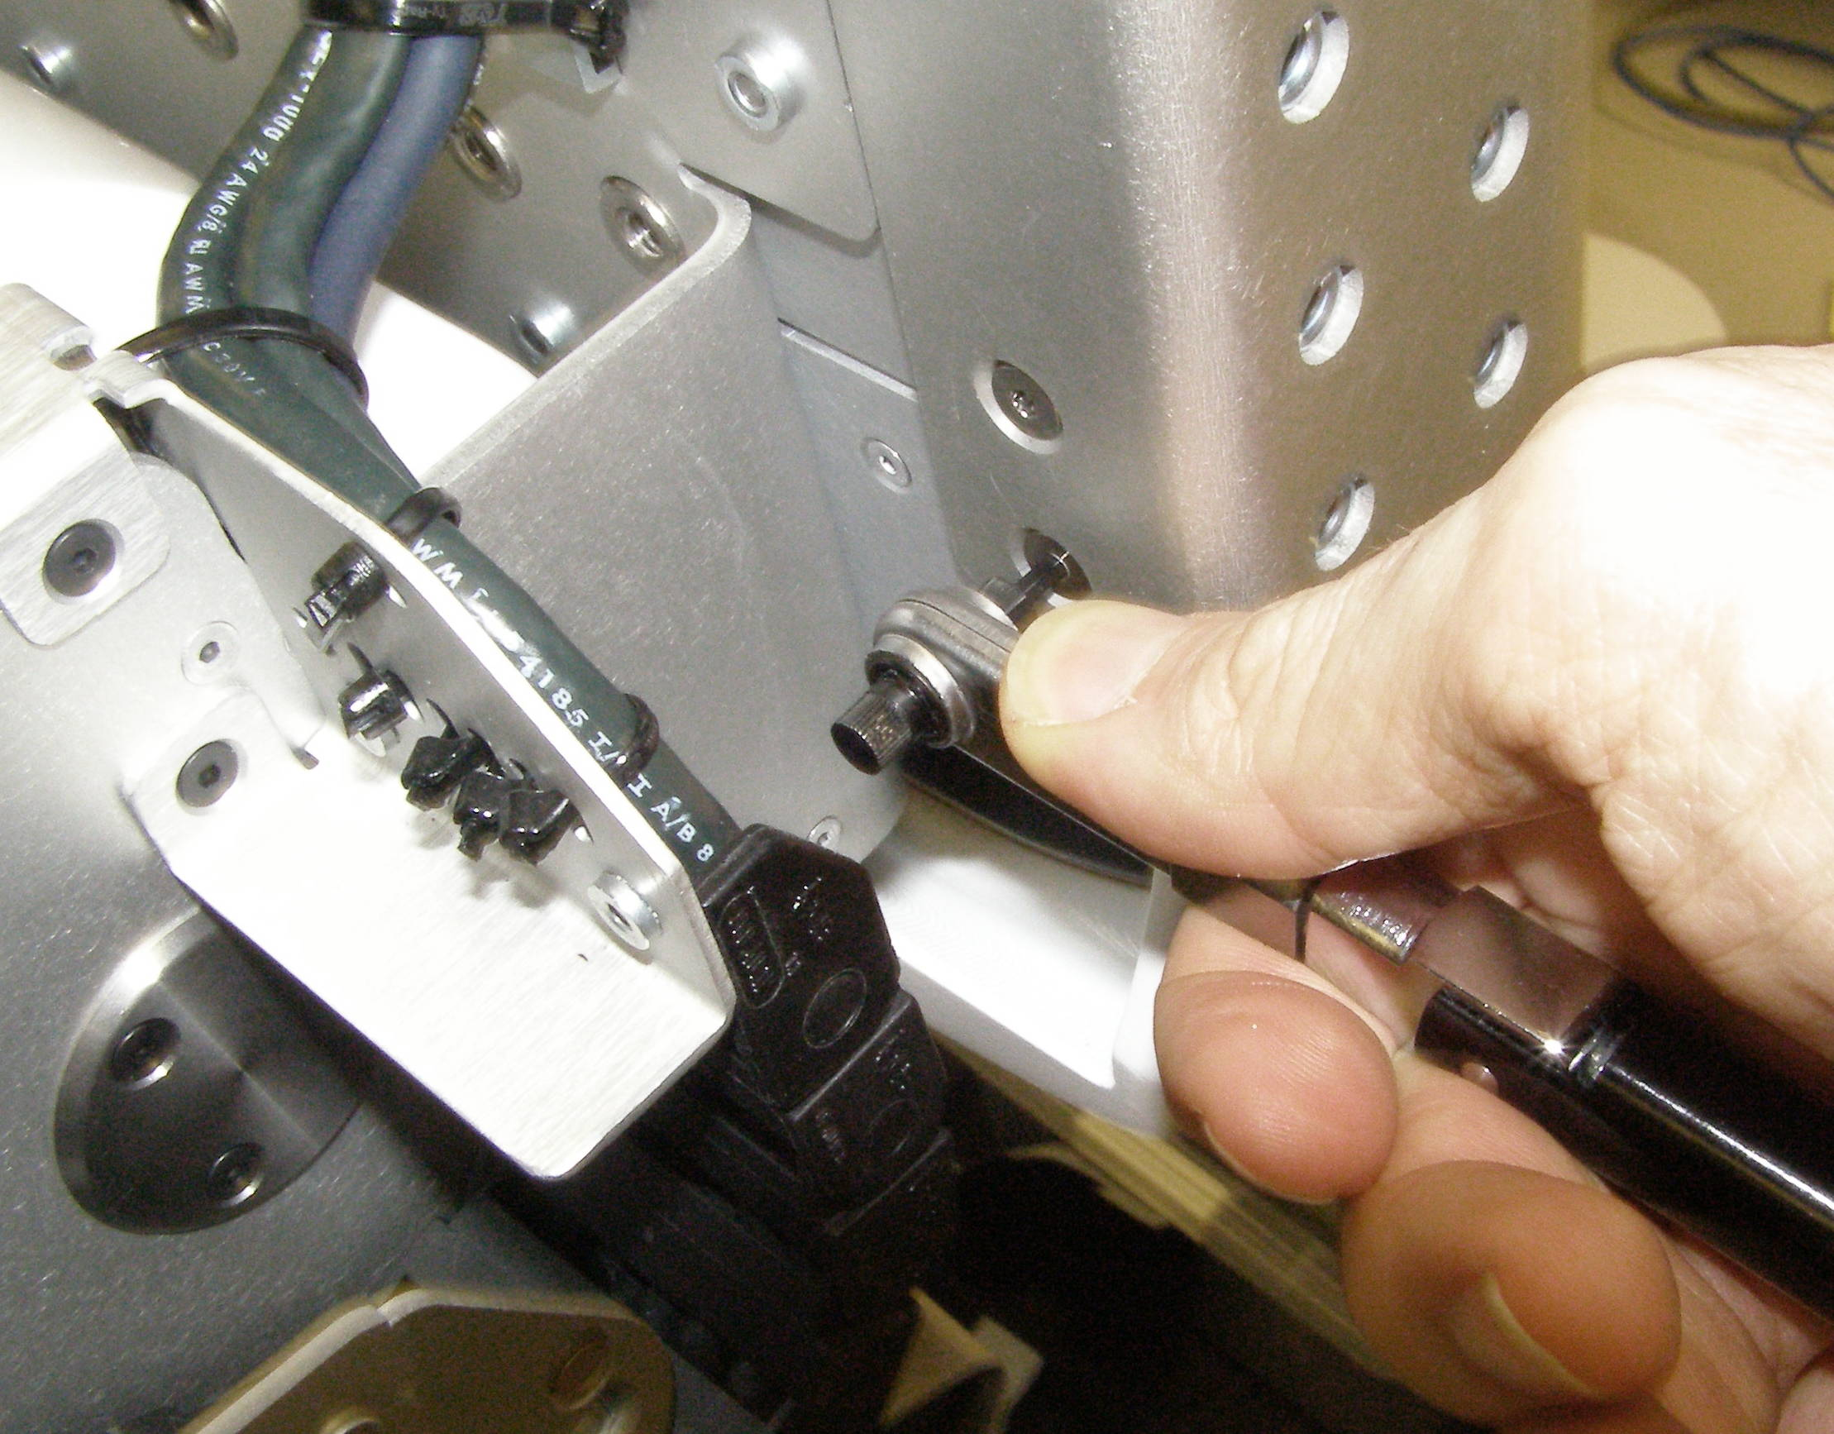
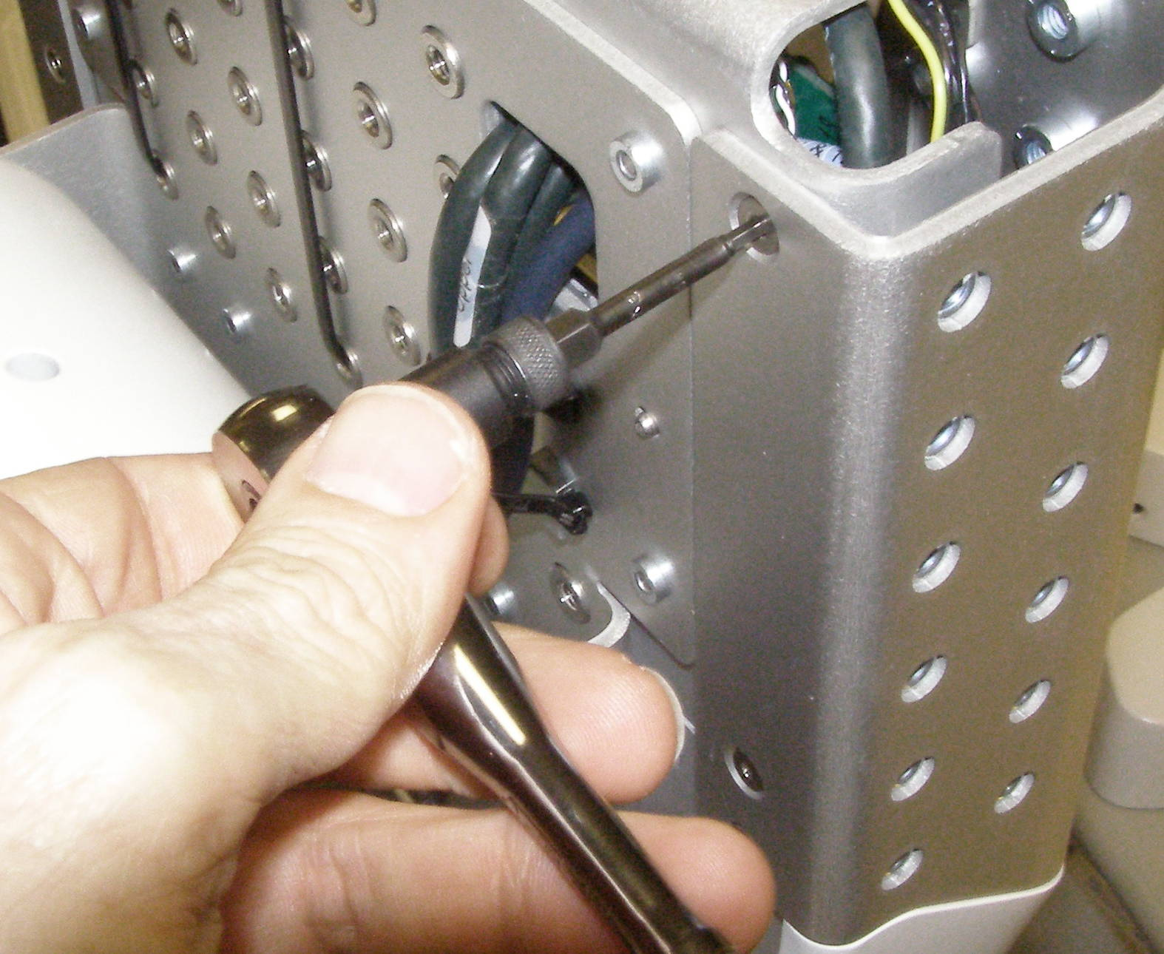
Head Bonnet R/R
Head Bonnet, Removal – 2428
  Remove the Head Pan-tilt Right and Left first.
  Remove the Head Hatch.
  Remove the Head Head Bezel Rear.
  Tilt the Head completely forward and using the 2.0mm right angle torque wrench together with the 2.5mm short bit with (OUT) facing up, remove the 6 Flathead screws. 3064-08
  (Fig 1,2)
  For the top 2 screws it may be easier to use the ¼ drive wrench with the hex ¼ adapter and the 2.5mm bit. (Fig 3)
  Tilt the Head all the way back and angling the Bonnet slightly slide it back off of the Head, making sure it clears the screw mounting tab. (Fig 4)
Head Bonnet, Install
  Reverse the removal procedure.
  Using Loctite 248, install the 6 screws and torque to 2.0Nm using the Large torque driver.
Fig 4
Fig 1
Fig 2
Fig 3

Slide 5
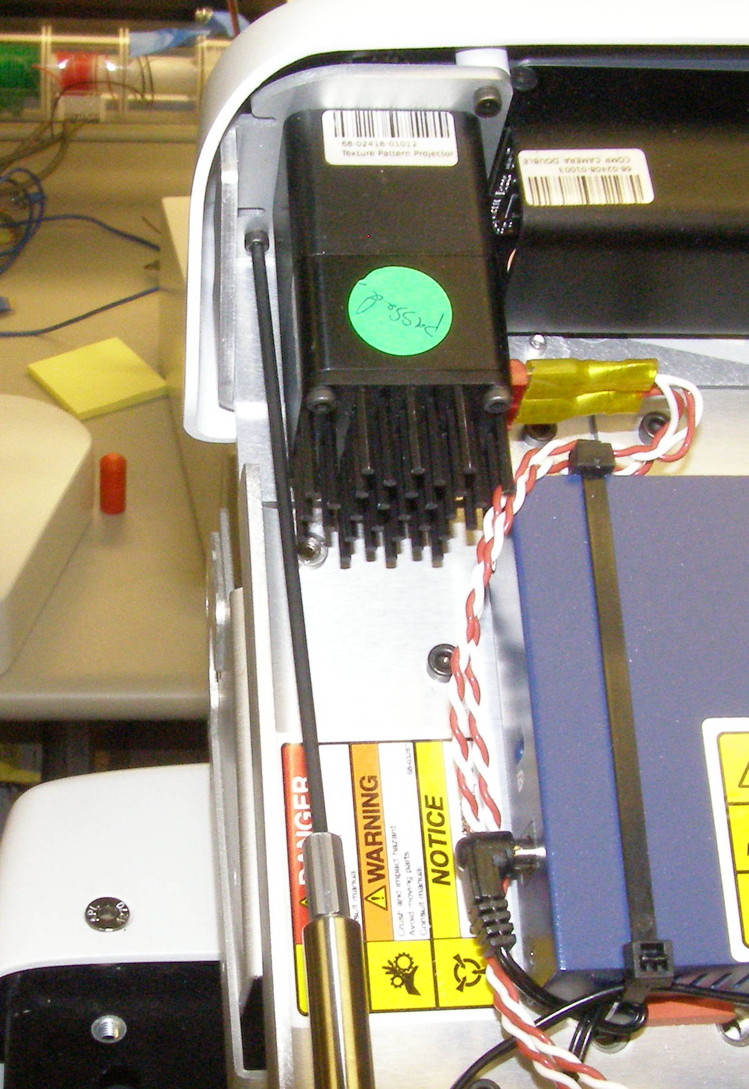
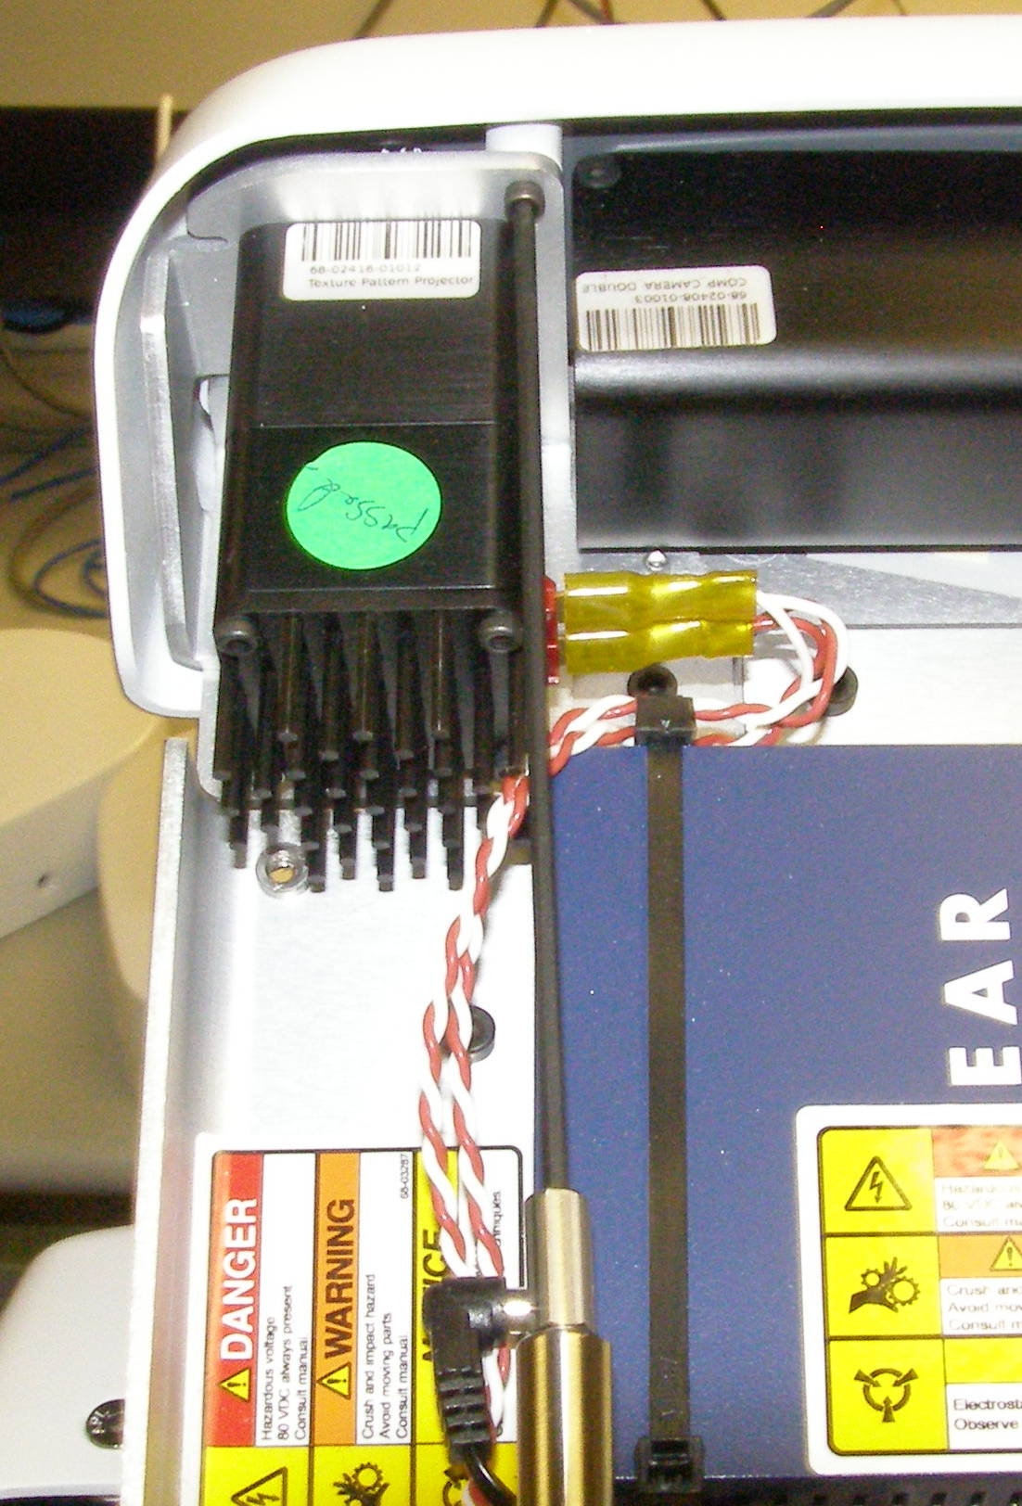
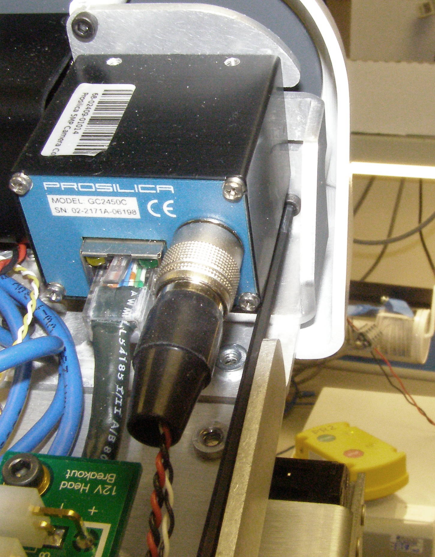
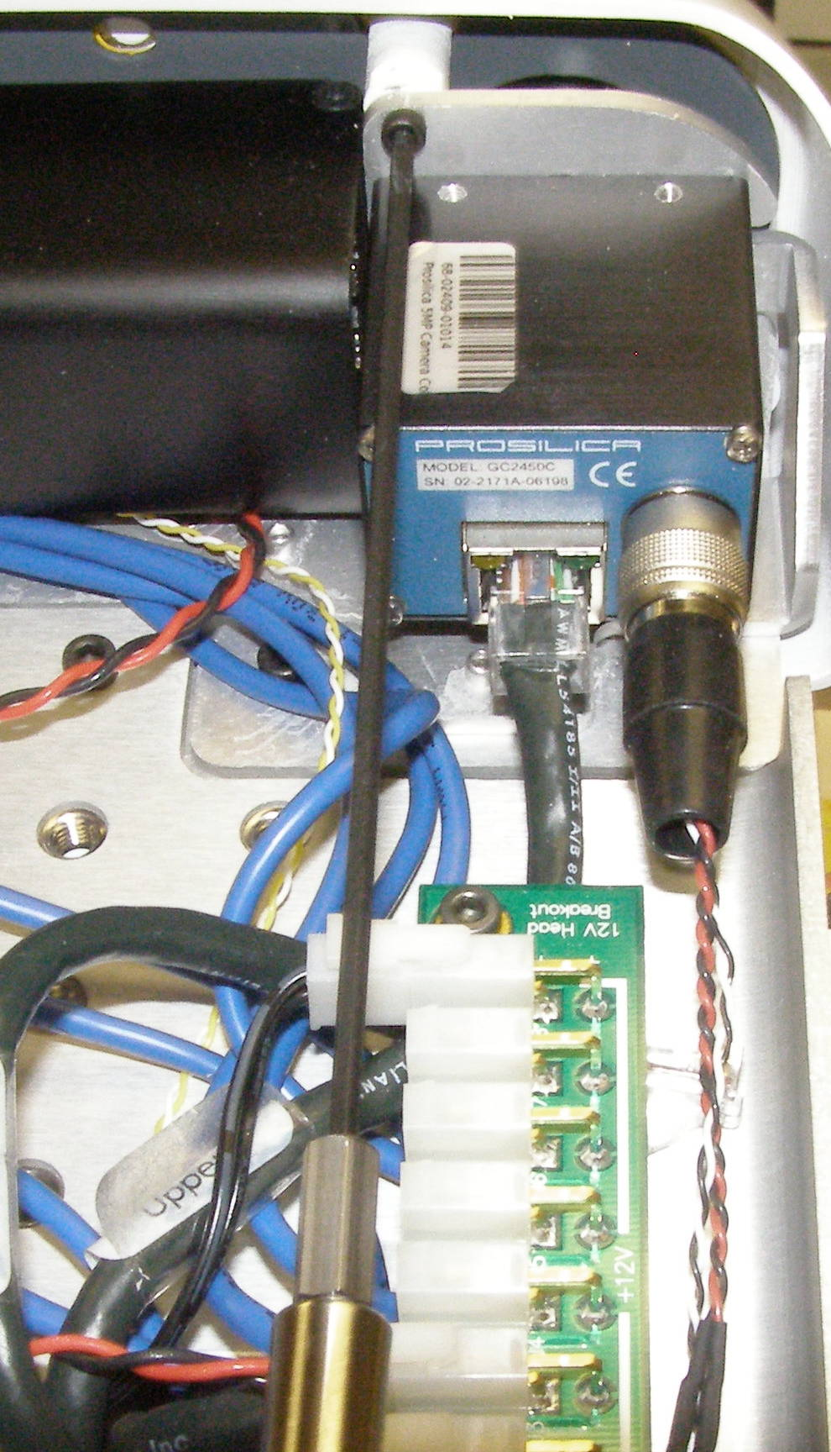
Head Bezel R/R
Head Bezel, Removal - 3081
  Remove the Head Pan-tilt Right and Left first.
  Remove the Head Hatch.
  Remove the Head Head Bezel Rear.
  Remove the Head Bonnet.
  Tilt the Head completely forward .
  Using the 2.5mm ball end bit with the T-handle driver, remove the 4 screws. 2009-08 (Fig 1-4)
Head Bezel, Install
  Reverse the removal procedure.
  Using Loctite 248, install the 4 screws and torque to 0.68Nm using the Small torque driver.
Fig 2
Fig 2
Fig 1
Fig 4
Fig 3

